Slide 1
CCIE Enterprise Bootcamp
IPv6 Foundation

Slide 2
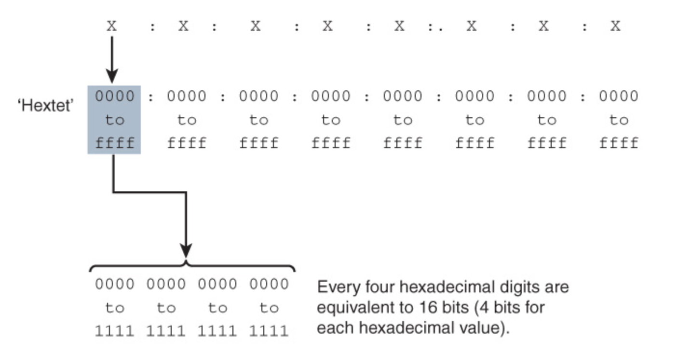
IPv6 Addressing
As described in RFC 4291, the preferred form is x:x:x:x:x:x:x:x
Each x is a 16-bit section

Slide 3
IPv6 Addressing
RFC 2373 and RFC 5952 provide two helpful rules for reducing the notation involved in the preferred format
Rule 1: Omit Leading 0s
Rule 2: Omit All-0s Hextets
Combining Rule 1 and Rule 2

Slide 4
IPv6 Addressing
IPv4, with its 32-bit address space, provides for 4.29 billion
IPv6 - 340,282,366,920,938,463,463,374,607,431,768,211,456 addresses

Slide 5
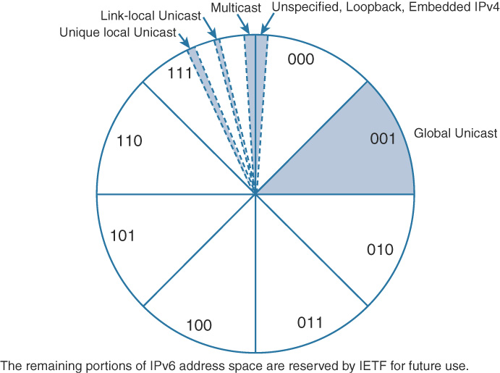
IPv6 Addressing

Slide 6
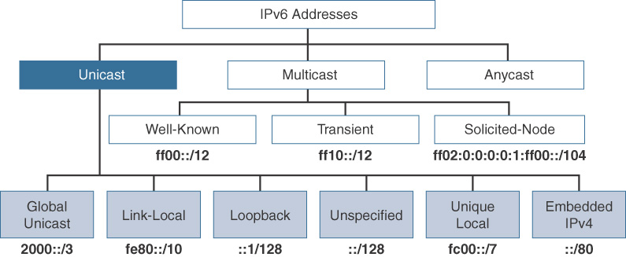
IPv6 Addressing

Slide 7
IPv6 Unicast Adresses
Global unicast
Link-local
Loopback
Unspecified address
Unique local
IPv4 embedded

Slide 8
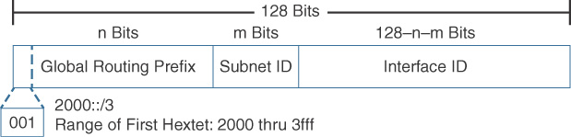
Global Unicast Address
Global Routing Prefix
Subnet ID
Interface ID

Slide 9
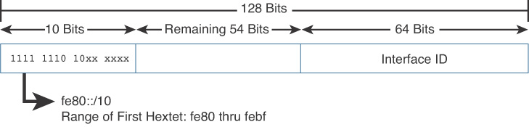
Link-Local Unicast Address

Slide 10
Link-Local Unicast Address
device must have an IPv6 link-local address
Link-local addresses are not routable off the link
Link-local addresses only have to be unique on the link
There can be only one link-local address per interface

Slide 11
Link-Local Unicast Address
Devices dynamically (automatically) create their own link-local IPv6 address upon startup
Link-local addresses can be manually configured
When a device starts up, before it obtains a GUA address, the device uses its IPv6 link-local address as its source address to communicate with other devices on the network
Devices use the router’s link-local address as their default gateway address
IPv6 routing table entries populated from dynamic routing protocols use the IPv6 link-local address as the next-hop address

Slide 12
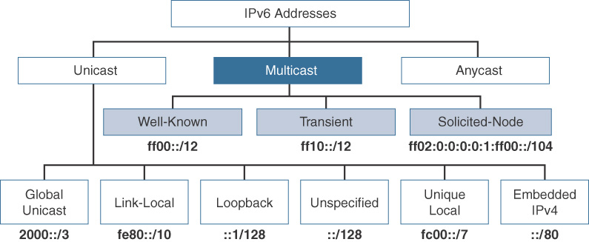
MULTICAST ADDRESSES

Slide 13
Well-Known Multicast Addresses
ff02::1:
All IPv6 devices
ff02::2:
All IPv6 routers
ff02::5:
All OSPFv3 routers
ff02::a:
All EIGRP (IPv6) routers

Slide 14
Solicited-Node Multicast Addresses
used as a more efficient approach to IPv4’s broadcast address
used in Layer 3-to-Layer 2 address resolution, similar to how Address Resolution Protocol (ARP) is used in IPv4
automatically created using a special mapping of the device’s unicast address with the solicited-node multicast prefix ff02:0:0:0:0:1:ff00::/104

Slide 15
Dynamic Addressing
Method 1: Stateless Address Autoconfiguration (SLAAC)
Method 2: SLAAC and a stateless DHCPv6 server
Method 3: Stateful DHCPv6 server

Slide 16
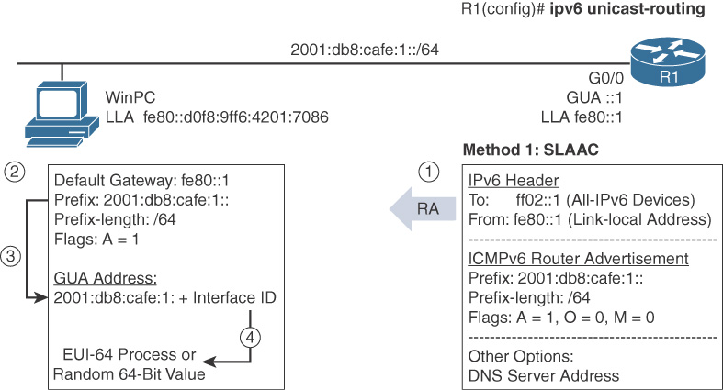
Method 1: SLAAC

Slide 17
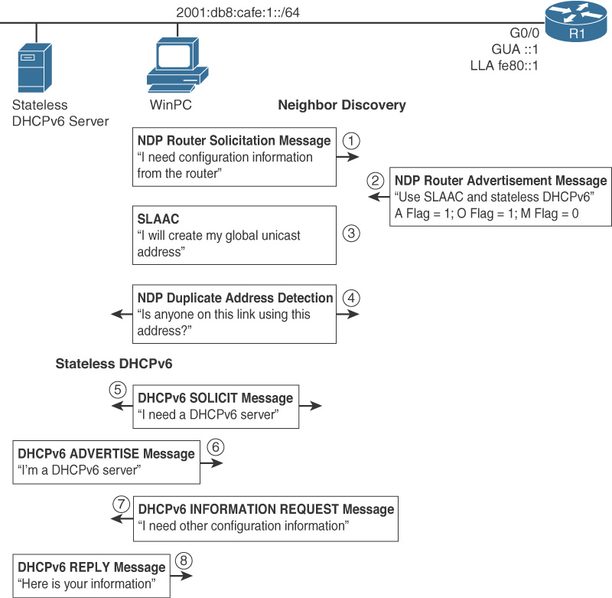
Method 2: stateless DHCPv6 server
! Configure the stateless DHCPv6 server pool R1(config)# ipv6 dhcp pool STATELESS-DHCPv6 R1(config-dhcpv6)# dns-server 2001:db8:cafe:1::8888 R1(config-dhcpv6)# domain-name example.com R1(config-dhcpv6)# exit ! Set the O flag to 1 and enable DHCPv6 service R1(config)# interface gigabitethernet 0/0 R1(config-if)# ipv6 nd other-config-flag R1(config-if)# ipv6 dhcp server STATELESS-DHCPv6 R1(config-if)#

Slide 18
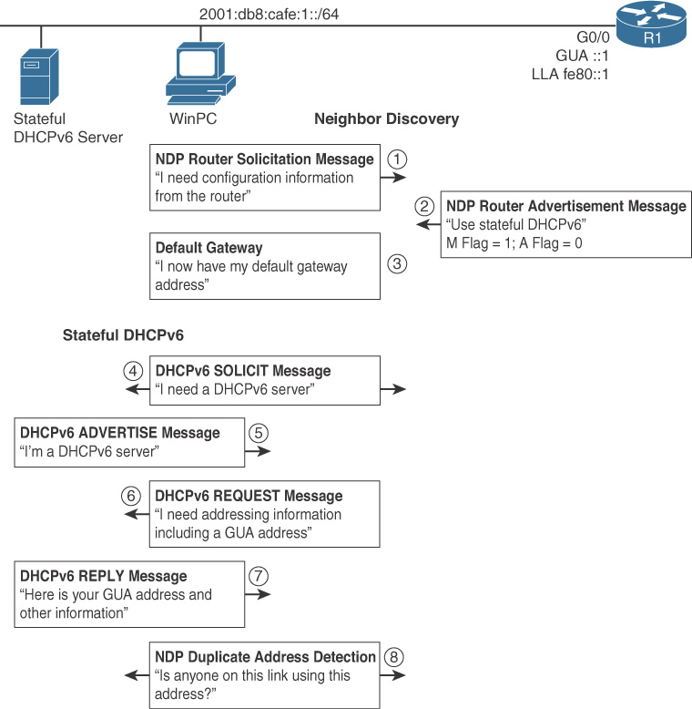
Method 3: Stateful DHCPv6
! Configure the stateful DHCPv6 server pool R1(config)# ipv6 dhcp pool STATEFUL-DHCPv6 R1(config-dhcpv6)# address prefix 2001:db8:cafe:1:deed::/80 R1(config-dhcpv6)# dns-server 2001:db8:cafe:1::8888 R1(config-dhcpv6)# domain-name example.com R1(config-dhcpv6)# exit ! Set the M flag to 1, the A flag to 0 and enable DHCPv6 service on the interface R1(config)# interface gigabitethernet 0/0 R1(config-if)# ipv6 nd managed-config-flag R1(config-if)# ipv6 nd prefix 2001:db8:cafe:1::/64 no-autoconfig R1(config-if)# ipv6 dhcp server STATEFUL-DHCPv6

Slide 19
ICMPv6 Neighbor Discovery
Router–device messages used for dynamic address allocation:
Router Solicitation (RS) message
Router Advertisement (RA) message
Device–device messages used for address resolution:
Neighbor Solicitation (NS) message
Neighbor Advertisement (NA) message
Router–device messages used for better first-hop selection:
Redirect message

Slide 20
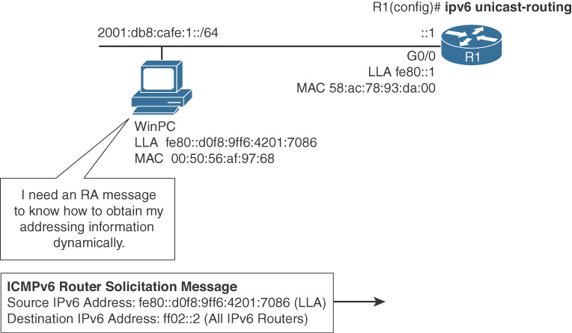
Router Solicitation Message
A host sends a Router Solicitation message when it needs to know how to dynamically obtain its addressing information. This typically occurs during startup and is the default on most host operating systems

Slide 21
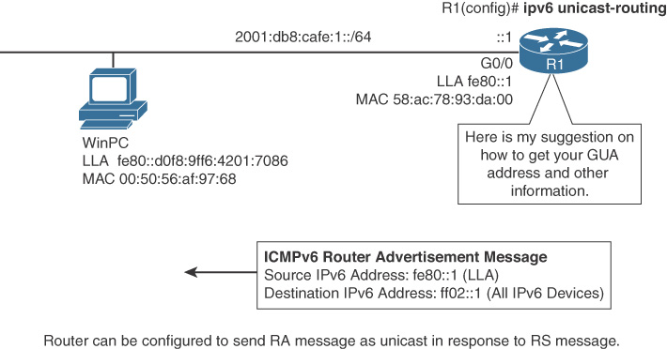
Router Advertisement Message
A Cisco router sends Router Advertisement messages every 200 seconds The RA message is a suggestion to obtain addressing information dynamically. This information in the RA message includes prefix, default router, and other configuration information

Slide 22
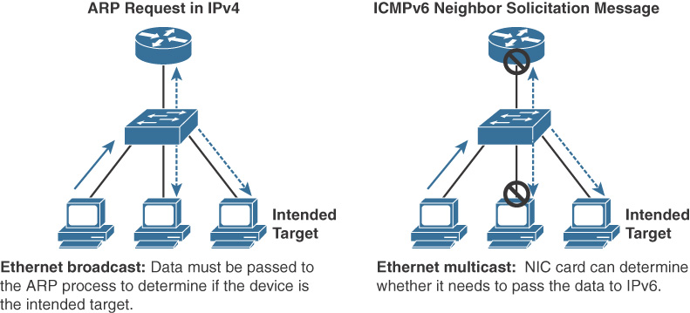
Neighbor Solicitation

